Slide 1
CAPSTONE PYTHON
Alfin Sam Mathew
ENROLL.: EN12024078062
Batch : DA132S13

Slide 2
Introduction
Join us on a Python-powered journey through the world of movies. In this project, we'll unravel the mysteries of why even high-budget films can fail and explore what types of movies succeed in theaters. With Peter, our data analyst, at the helm, we'll analyze movie data to uncover trends, identify successful genres, and predict movie outcomes. Get ready for a cinematic adventure in data analysis!

Slide 3
Objective
Analyze movie data
Understand why high-budget movies fail
Help production company to identify successful movie genres
Predict commercial success.

Slide 4
ANALYSIS

Slide 5
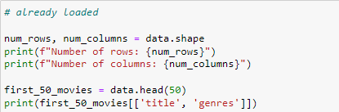
Task 1: Titles and genres of the first 50 movies from the dataset. ___________________________________________________________________________
There are total of 4803 rows and 20 columns.

Slide 6
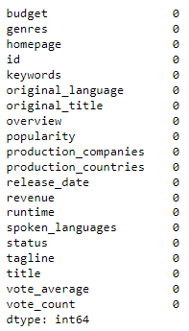
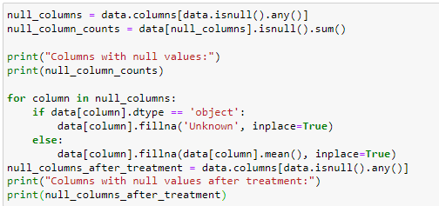
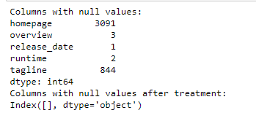
Task 2: Columns that have null values and performing the null value treatment. ______________________________________________________________________________________________________
There were 3091 null values in homepage column, 3 in overview, 1 in release date, 2 in runtime and 844 in tagline columns before cleaning.

Slide 7
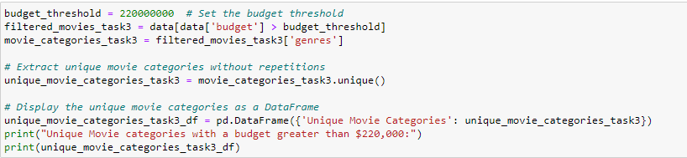
Task 3: Movie categories that have a budget greater than 220,000$ _________________________________________________________________________________________________________________
There are 16 movie categories in total with budget greater than $220,000 .

Slide 8
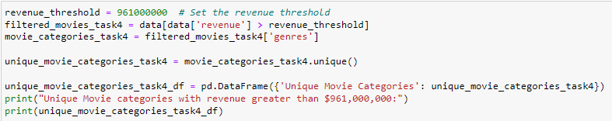
Task 4: Movie categories where the revenue is greater than $961,000,000 _________________________________________________________________________________________________________________
There are 20 movie categories in total with revenue greater than $961,000,000

Slide 9
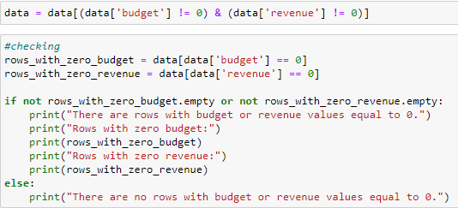
Task 5: Removing the rows with value 0 from both the budget and revenue columns. _________________________________________________________________________________________________________________
Cleared all. Now there are no rows with budget or revenue values equal to 0.

Slide 10
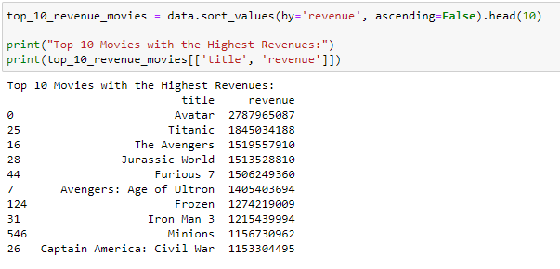
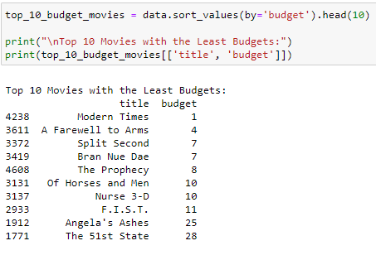
Task 6: Top 10 movies with the highest revenues and the top 10 movies with the least budget _________________________________________________________________________________________________________________
Top 10 with highest revenue.
‘Avatar’ has the highest revenue among them.
Top 10 with least budget.
‘Modern times’ has the least budget.

Slide 11
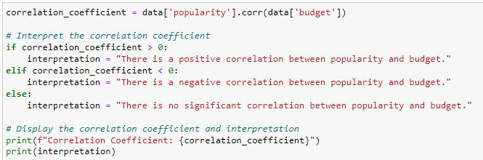
Task 7: How are popularities of movies related with the movie budgets? Are they correlated or totally uncorrelated with each other? _________________________________________________________________________________________________________________
The correlation coefficient is positive (close to 1), it suggests a positive correlation, meaning that as movie budgets increase, their popularity tends to increase as well.

Slide 12
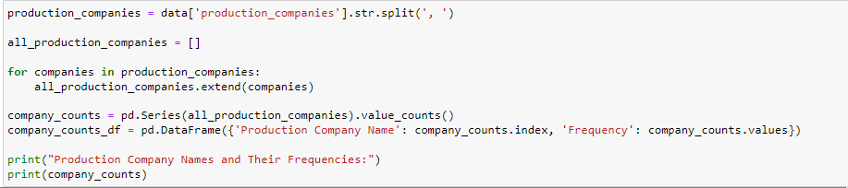
Task 8: Names of all production companies along with the number of times they appear in the dataset. _________________________________________________________________________________________________________________
Paramount pictures is the company which is most appeared in the dataset.

Slide 13
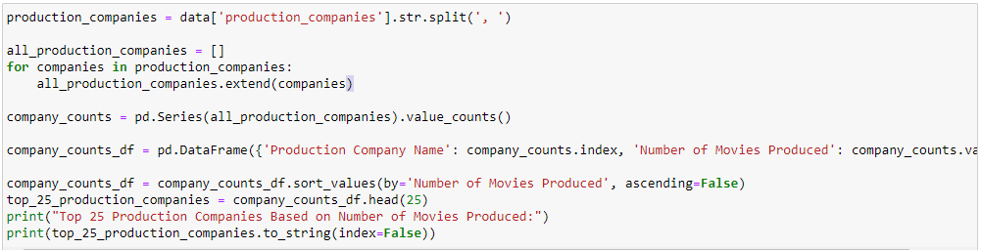
Task 9: Names of the top 25 production companies based on the number of movies they have produced. _________________________________________________________________________________________________________________
“Paramount pictures” production house produced most number of movies

Slide 14
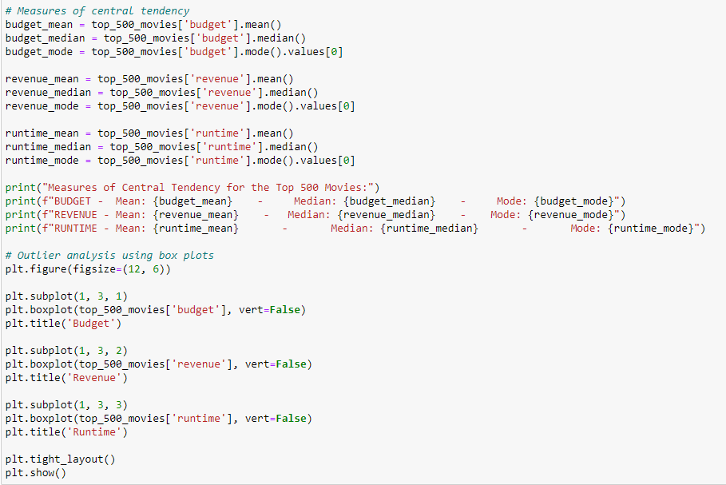

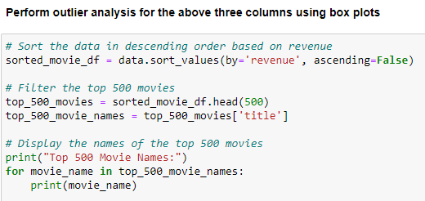
Task 10: Sort the data in descending order based on revenue and filter the top 500 movies. Find the measures of central tendency for the following columns using the filtered data i. Budget ii. Revenue iii. Runtime _____________________________________________

Slide 15
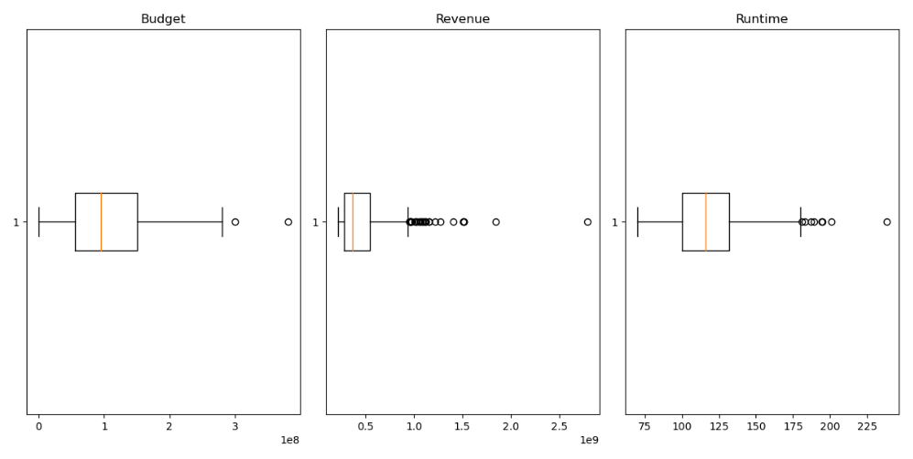
Task 10 (cont’d):
Revenue has more outliers compared to budget and runtime

Slide 16
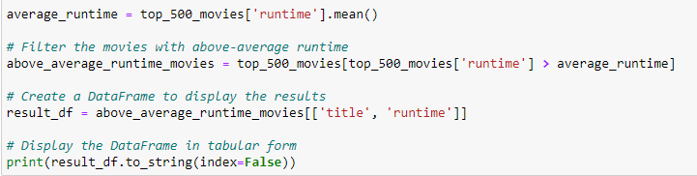
Task 11: Identify and display the names of the movies along with their run times for those movies that have above average runtime, using the data from the previous task. _________________________________________________________________________________________________________________
There are 234 movies with above average runtime

Slide 17
Insights
There are total of 4803 rows and 20 columns.
There were many null values in multiple columns
There are 16 movie categories in total with budget greater than $220,000 .
There are 20 movie categories in total with revenue greater than $961,000,000
Paramount pictures is most appeared production company in the dataset.
Revenue has more outliers compared to budget and runtime
Paramount picture produced most number of movies
There are 234 movies with above average runtime

Slide 18
Thankyou

